Slide 1
Comprehensive Analysis of Stack Overflow Posts
Department of Applied Data Science, San Jose State University
DATA 228: Big Data Technologies and Applications
Dr. Guannan Liu
By
Harivardhana Polireddi
Karthik Nimmagadda
Yashasvi Kotra
Naga Shreya C
Neha B

Slide 2
Introduction
Stack Overflow is a widely recognized community-based website for developers, launched in 2008, that has grown to be an essential resource for programmers looking to ask and answer questions about software development.
As a user-driven platform, members are encouraged to post questions, respond with answers, and vote on the responses they consider most helpful.
The site boasts a broad spectrum of programming topics, including various languages like Python, Java, and JavaScript, alongside web development frameworks, databases, and much more.
Stack Overflow has become a crucial tool for developers seeking advice and information across a diverse array of technical subjects.
This project aims to delve deeper into user behavior and community dynamics on Stack Overflow, a hub of active engagement in the programming world.

Slide 3
Problem statement and objective
The main goal of this project is to extract meaningful patterns, trends, and metrics reflecting the state-of-art and its evolution in both IT and the development sectors through a full analysis of Stack Overflow posts.
Identify the most common challenges developers face across different programming languages, frameworks, and tools.
Understand the dynamics of community engagement and support, including response times, acceptance rates of answers, and the correlation between question complexity and community interaction.
Track the evolution of programming trends over time, pinpointing the rise and fall of technologies and methodologies.

Slide 4
Dataset Details
The Stack Overflow dataset offers comprehensive details on questions posed on the Stack Overflow platform, encompassing elements like the question's title, the content of the question, the identity of the querying user, the timestamp of the query, and the relevant tags.
It further includes data on answers submitted by users, capturing the body of the answer, the responding user's identity, the timestamp of the response, and the answer's score.
This dataset is housed in a compressed XML format and is accessible through the Stack Exchange Data Dump archive, located on the archive.org website under the stack exchange directory listing.
The total size of the dataset is approximately 98 GB.
The dataset link - https://archive.org/download/stackexchange/

Slide 5
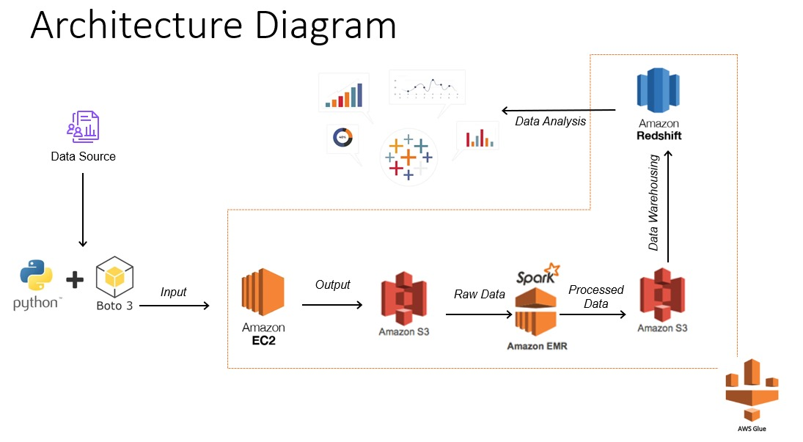
Project Architecture

Slide 6
Project Architecture Components
Boto3 - Package, AWS SDK for Python
EC2 - resizable compute capacity in cloud
EMR - for data processing with support of Apache Spark
Glue job - fully managed ETL service,
S3 - highly scalable, cost-efficient for storing high volumes of data
Redshift - as data warehouse, can run complex SQL queries on large datasets
Data Analysis

Slide 7
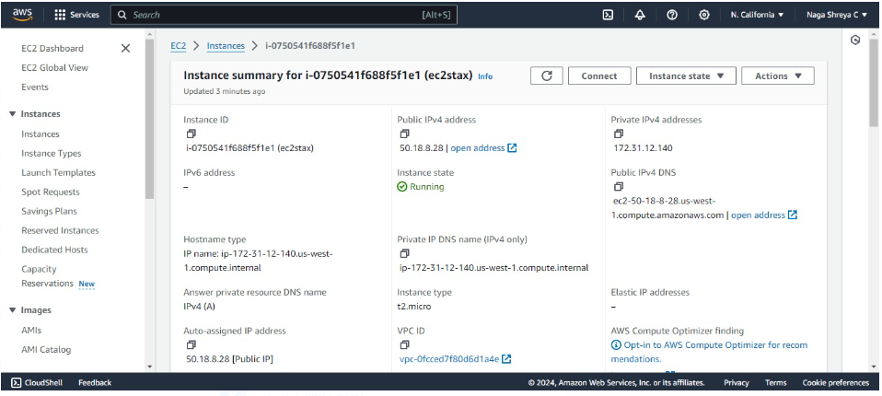
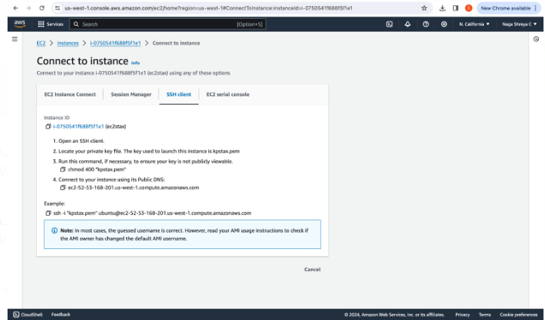
EC2-Instance creation
EC2 Instance Creation: Creating
an EC2 instance with
Ubuntu operating system
Connecting to EC2 Instance using
SSH Client

Slide 8
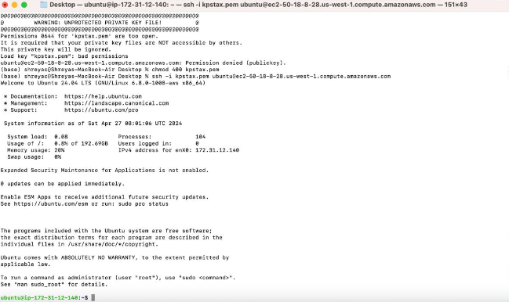
Data Retrieving from Website
Connecting with Local Terminal using SSH Protocol

Slide 9
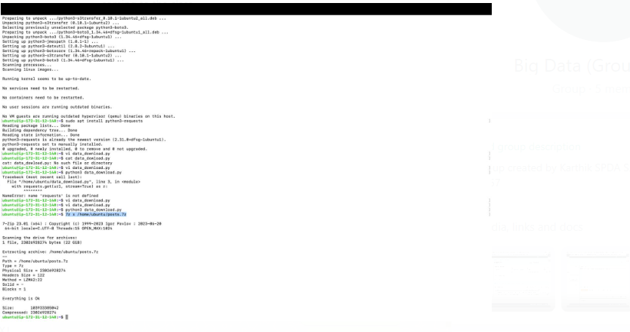
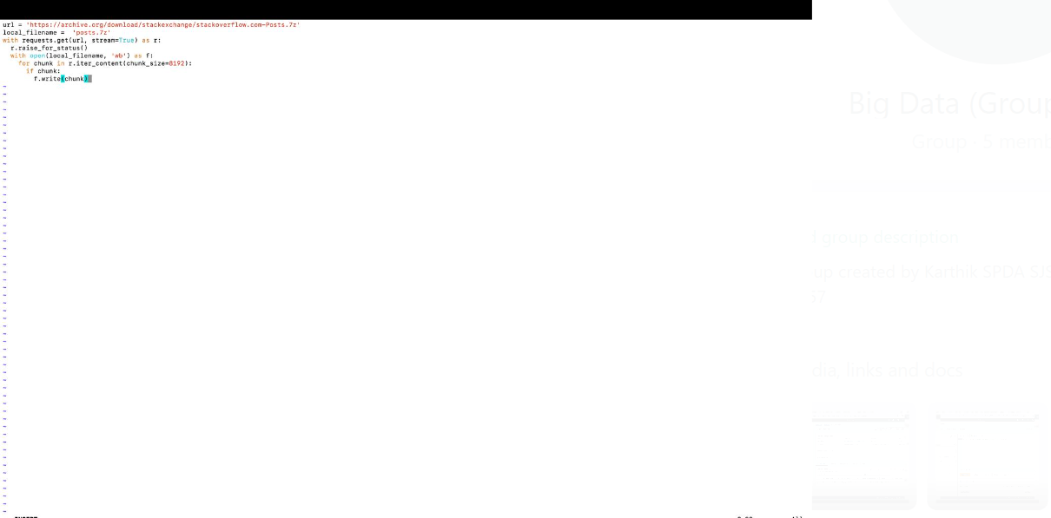
Extracting the stack overflow data from this link: 'https://archive.org/download/stackexchange/stackoverflow.com-Posts.7z’ in a compressed format. Once the data is downloaded (19 GB), decompress it using 7 zip to retrieve 98 GB of data, with the command 7z x /home/ubuntu/posts.7z

Slide 10
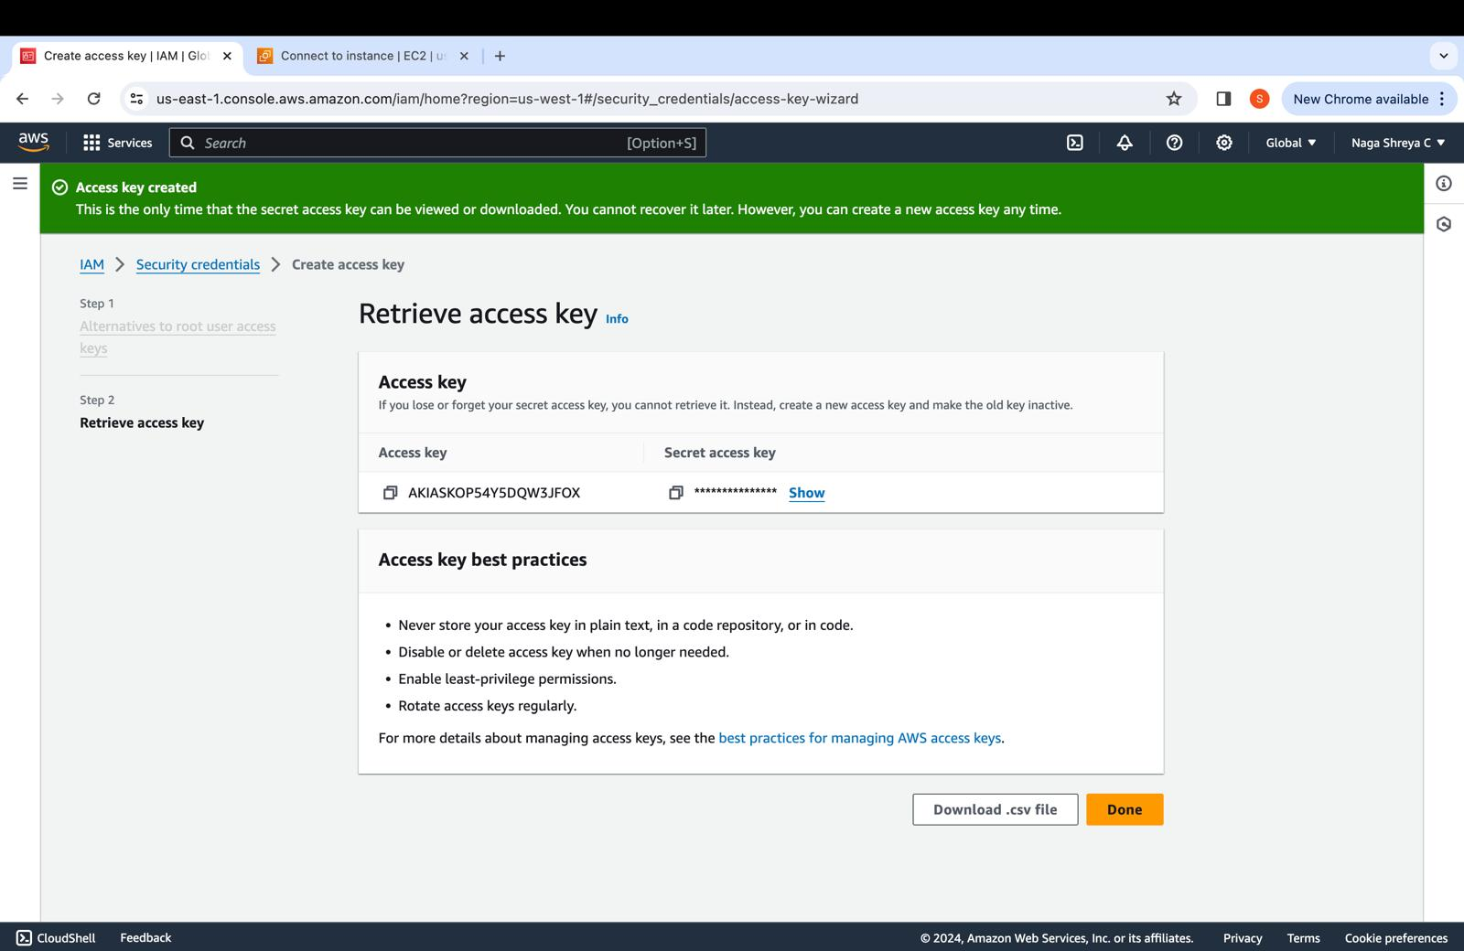
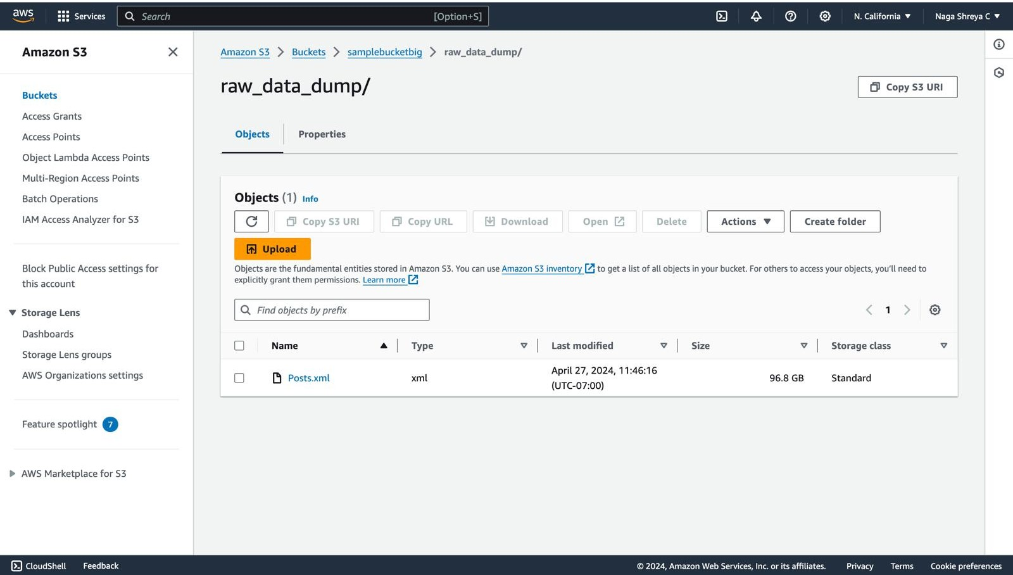
Data Storage – S3 bucket
Create a User and then Create Access key in the
Security Credentials Section of the user.
Creating an S3 Bucket to load data from
EC2 to S3

Slide 11
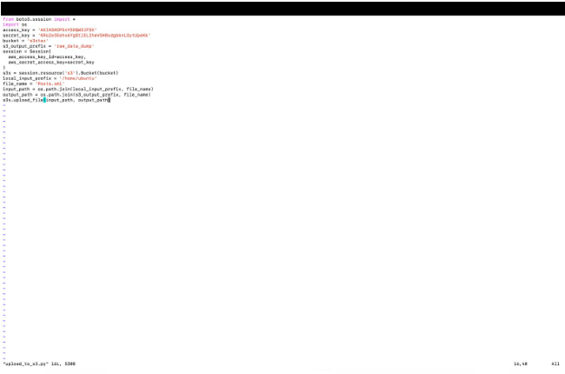
Data Storage – S3 bucket

Slide 12
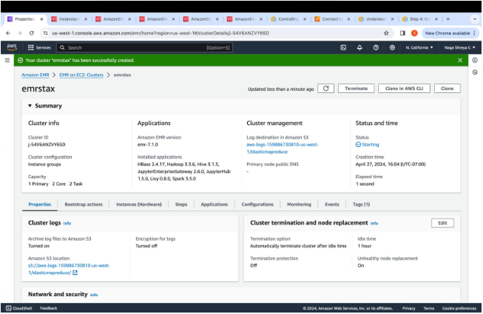
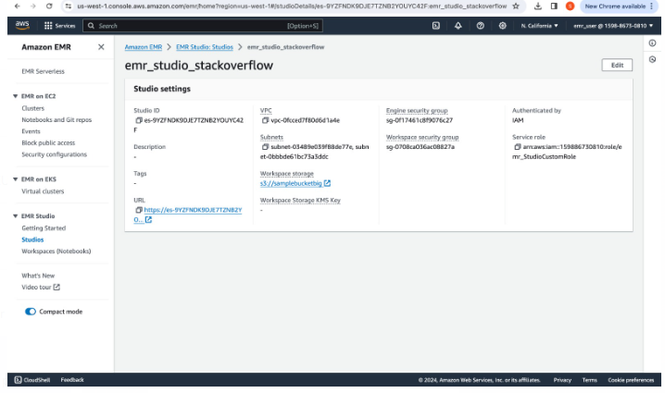
EMR-Cluster
Stack_overflow_cluster cluster is created, Cluster was
specified with 1 primary node, 2 task nodes and
2 core nodes and also on these nodes Jupyter notebook,
Spark,hive and Levi were installed.
Create EMR Studio

Slide 13
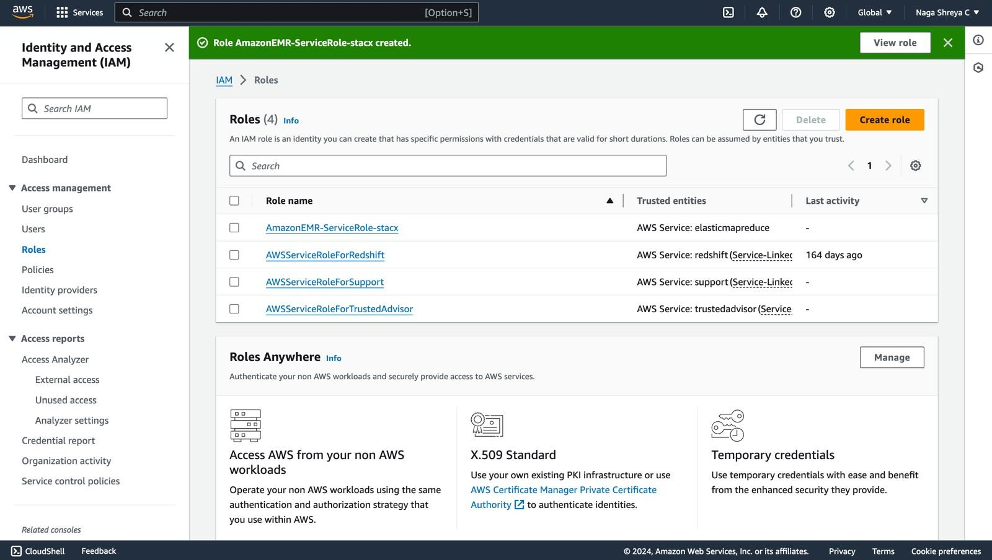
We encounter Servicerole error, so in the IAM Roles,
add PowerUserAccess to the service role created
while creating AWS EMR Cluster.

Slide 14
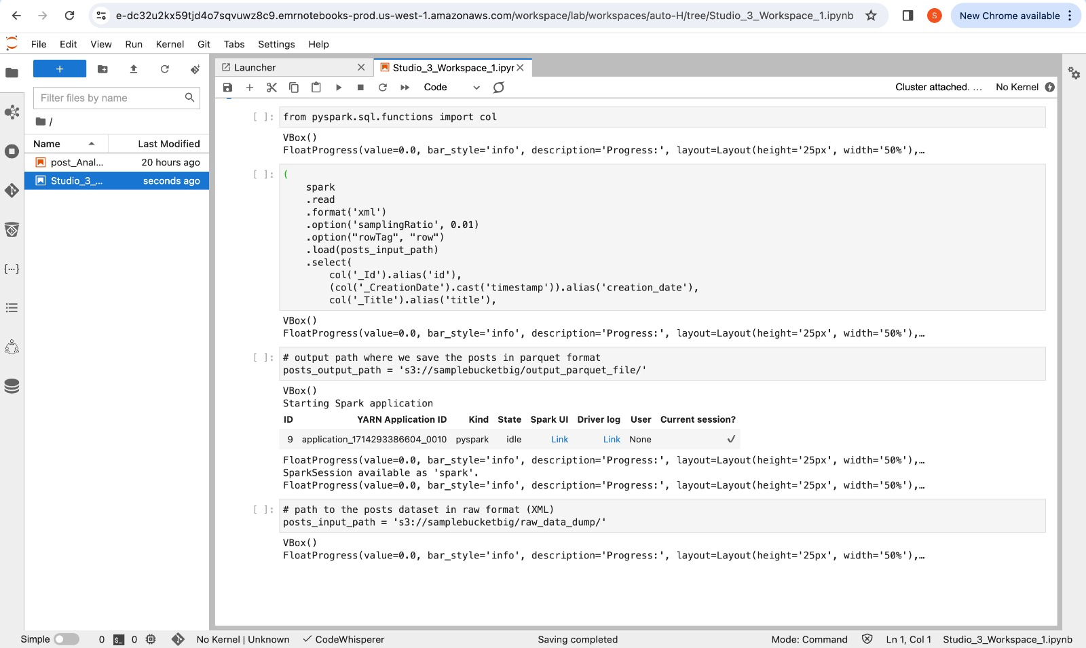
Data Preprocessing
Data Preprocessing steps: Changing the column names.

Slide 15
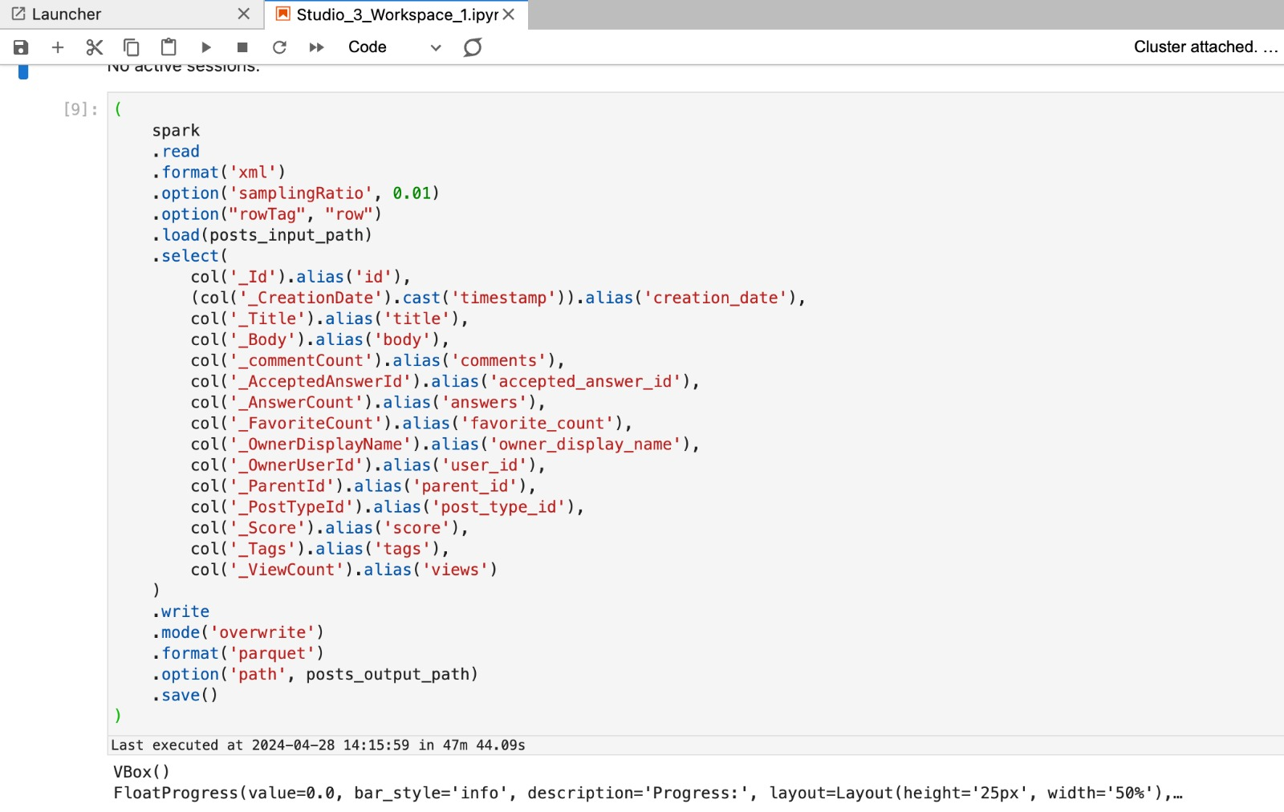
Data Transformations
Data processing steps performed in EMR Studio Workspace.

Slide 16
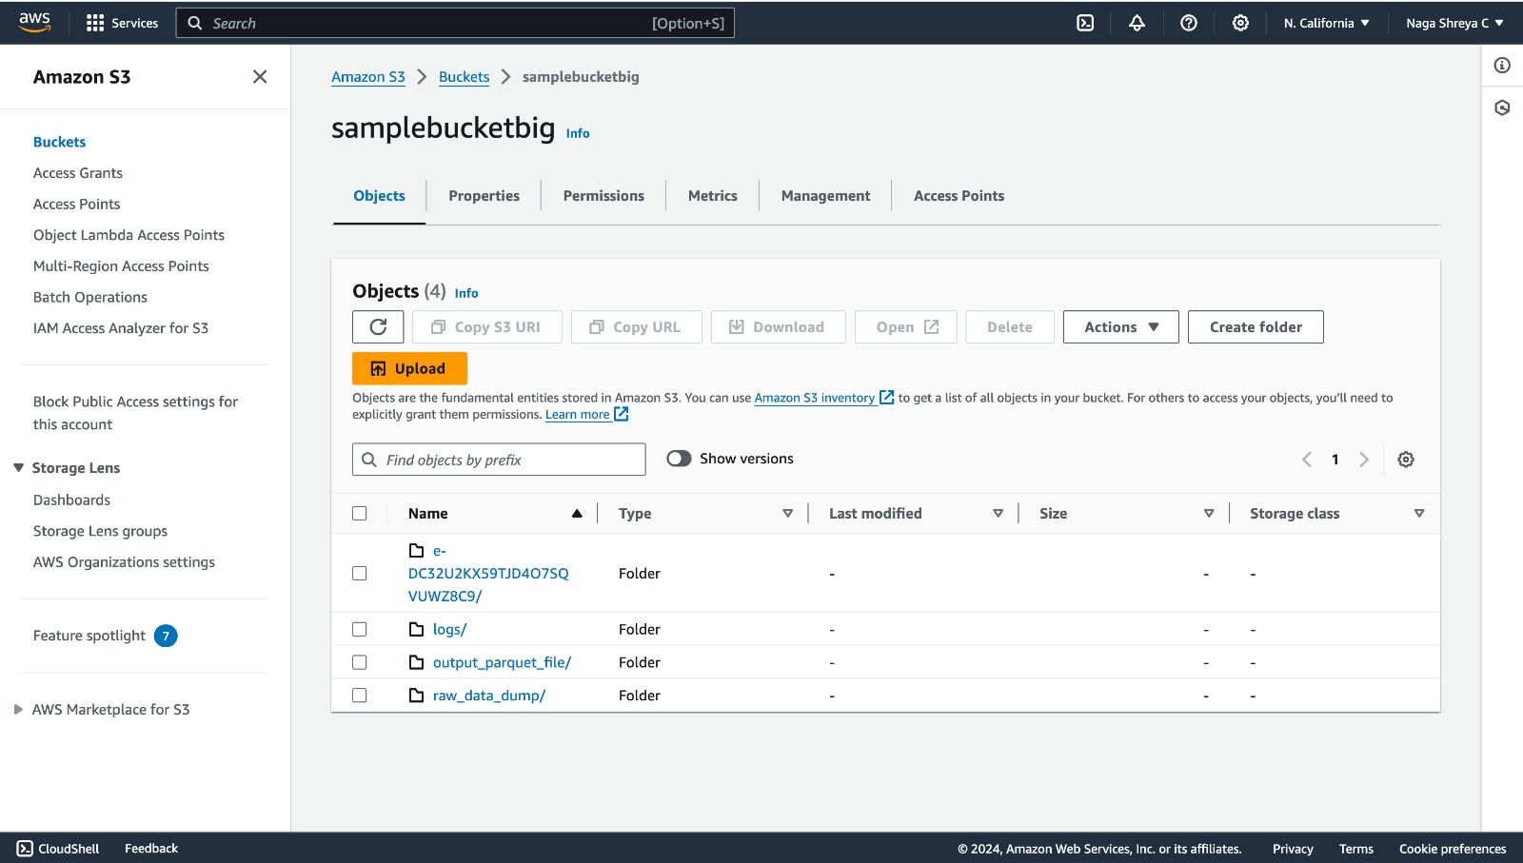
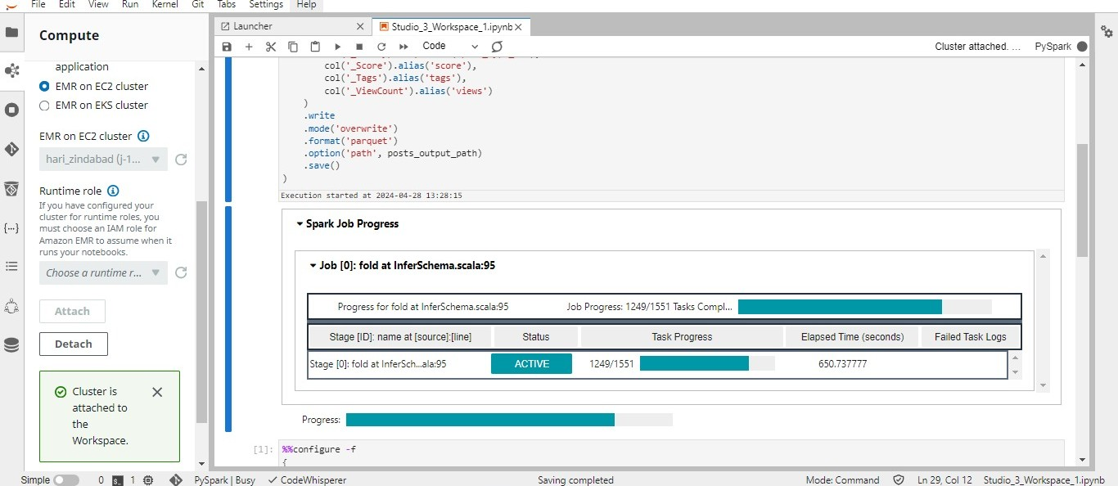
Data Transformation
Changing the data from XML to Apache Parquet, which is very convenient to perform data analysis in Spark.
Processed and Transformed Parquet File in S3 Bucket (output_parquet_file directory)

Slide 17
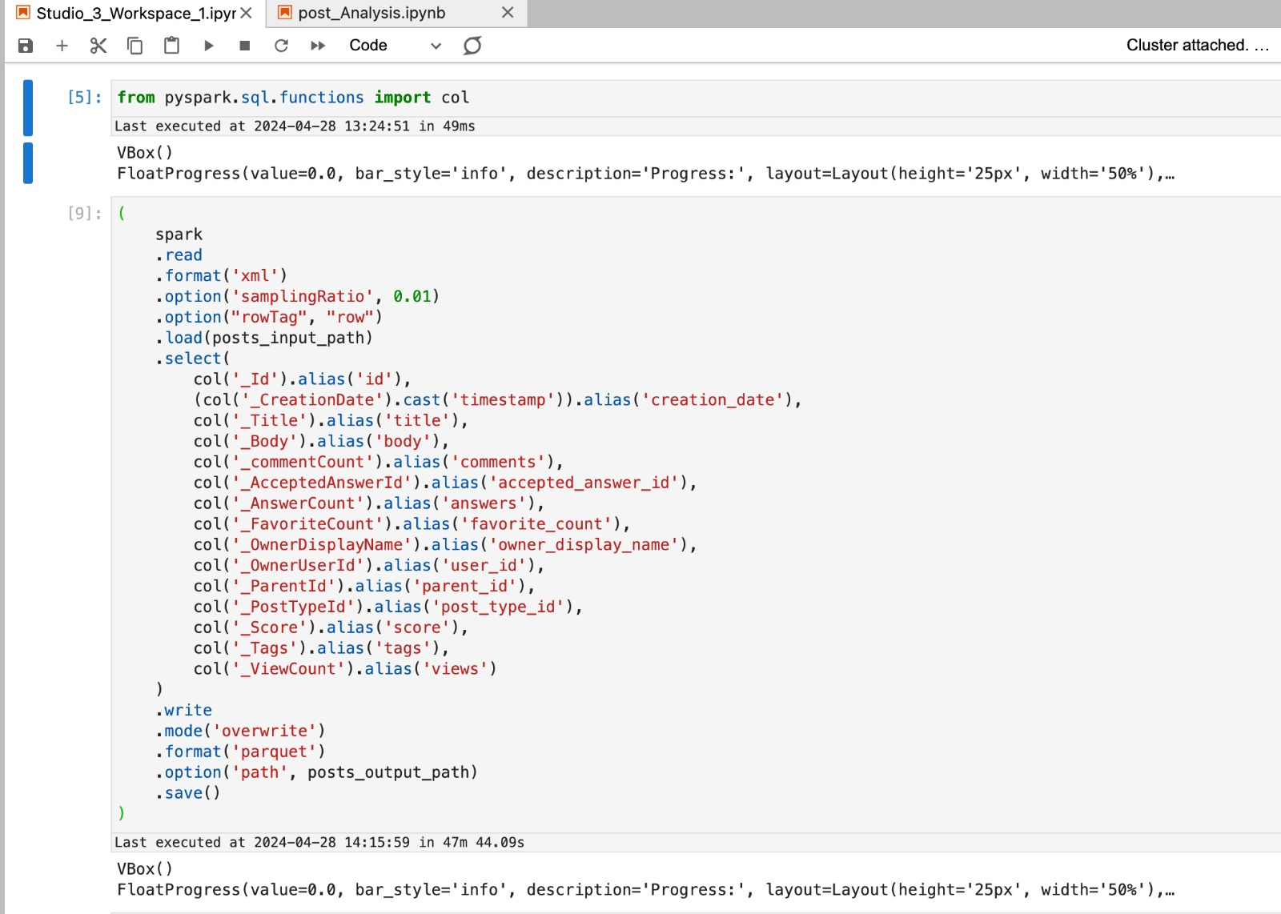
Automation Task Details
Pre-processing & XML to Parquet Transformation. After converting the data to Parquet, the size was reduced from 85.6 GB to 30 GB which is due to the Parquet compression and also because we didn't include all columns in the final Parquet.

Slide 18
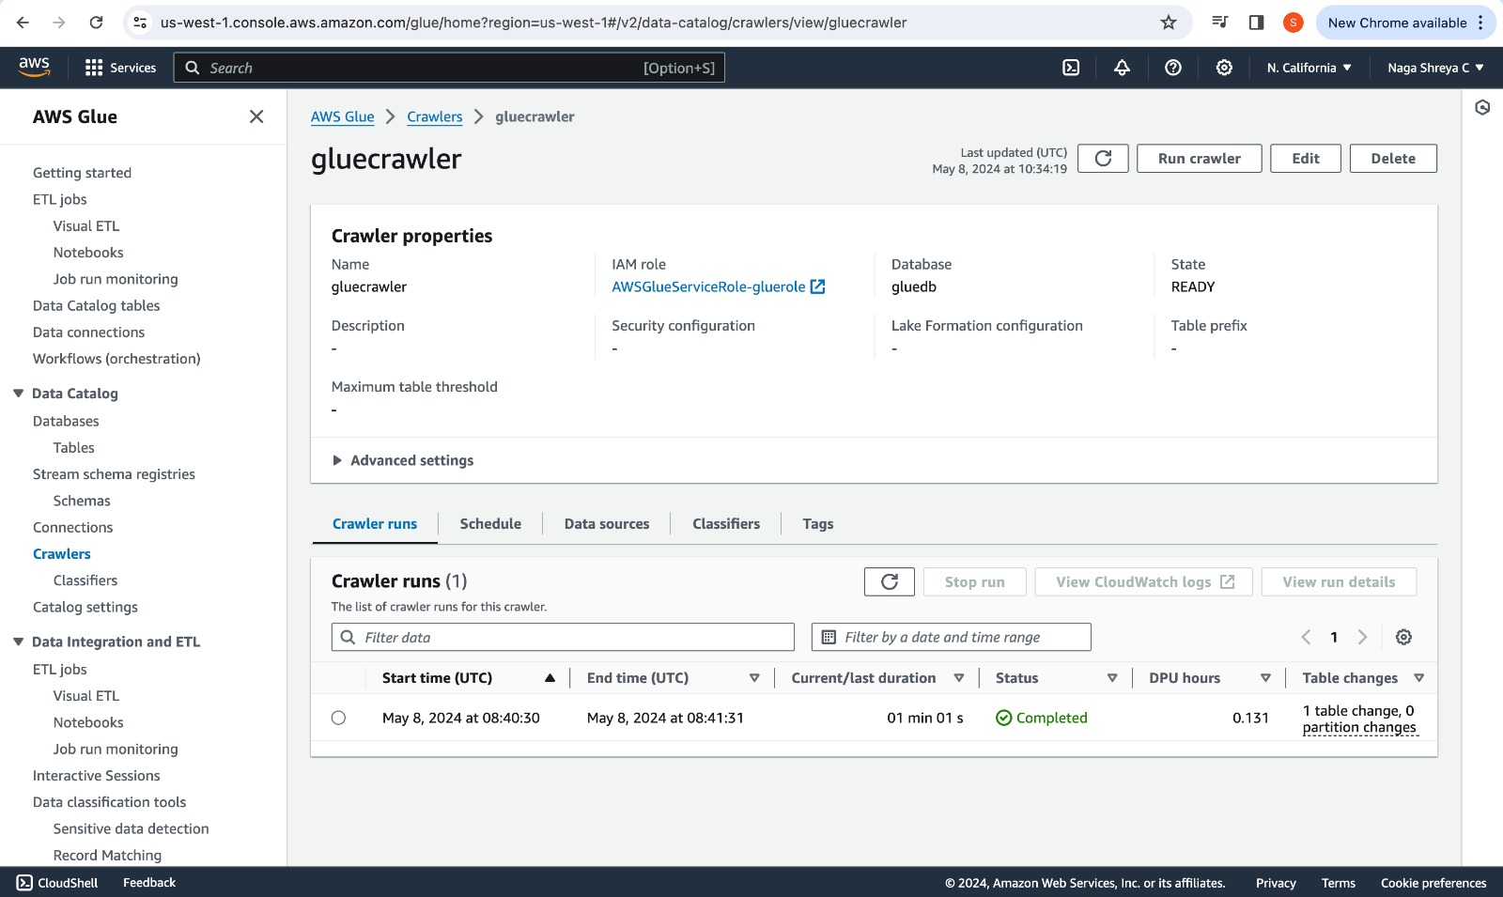
Automation with AWS Glue (Parquet to Redshift)

Slide 19
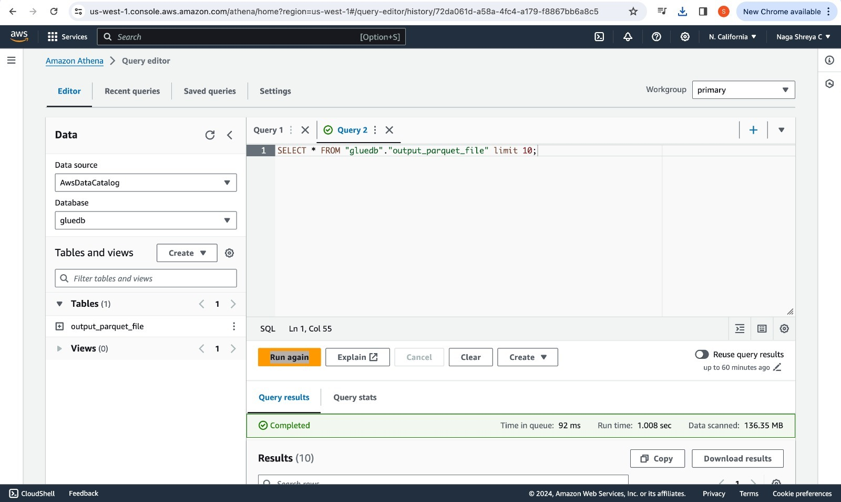
Automation with AWS Glue (Parquet to Redshift)

Slide 20
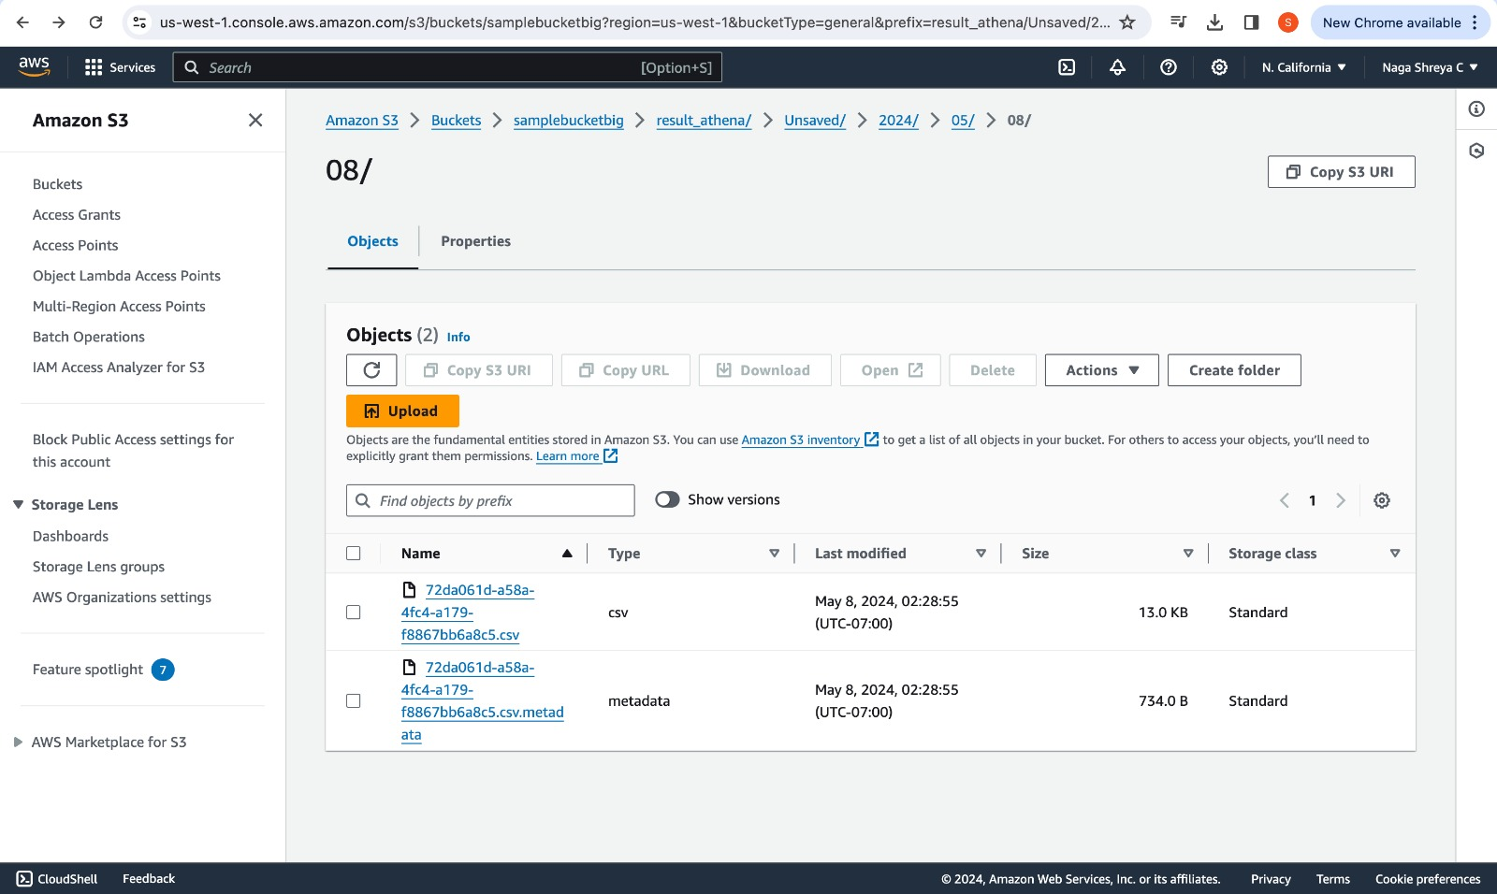
Automation with AWS Glue (Parquet to Redshift)

Slide 21
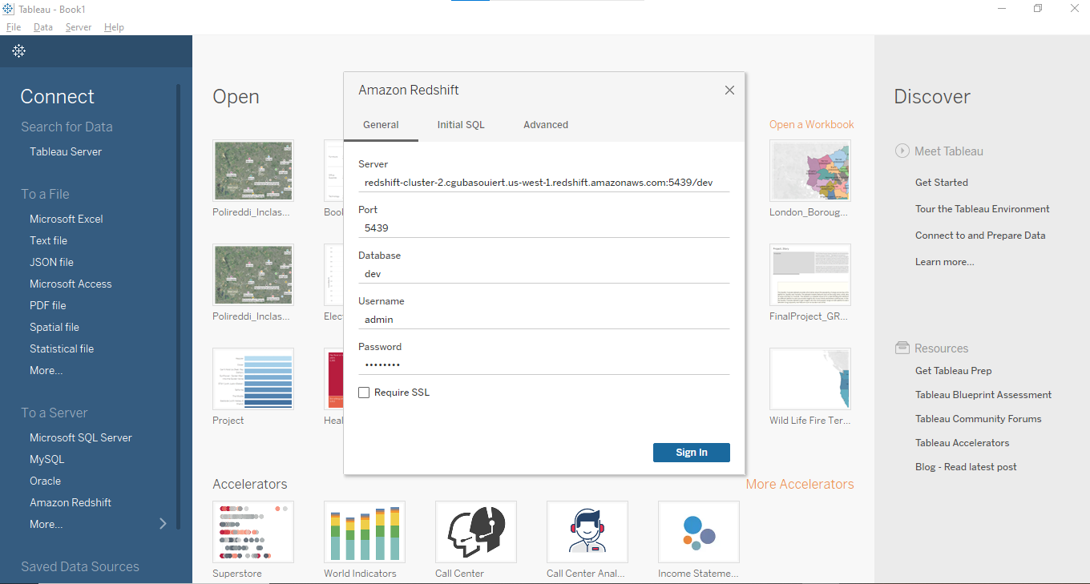
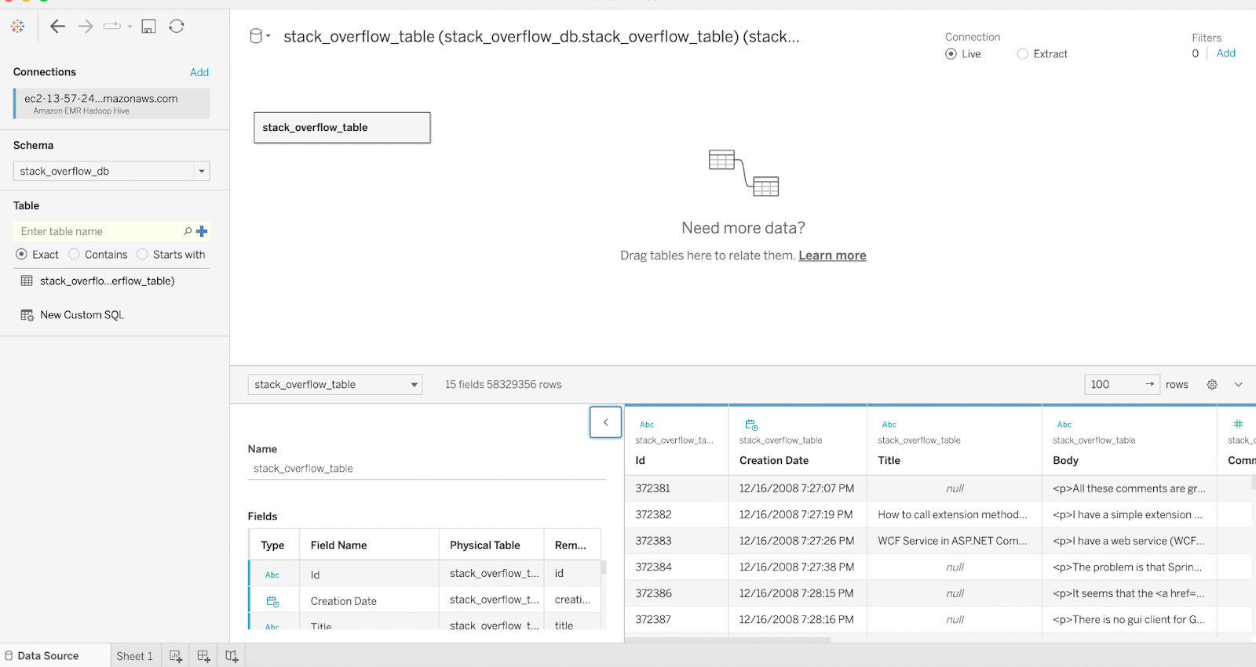
Data Analysis AND Visualizations
Analysis on the type of posts on the Stackoverflow dataset

Slide 22
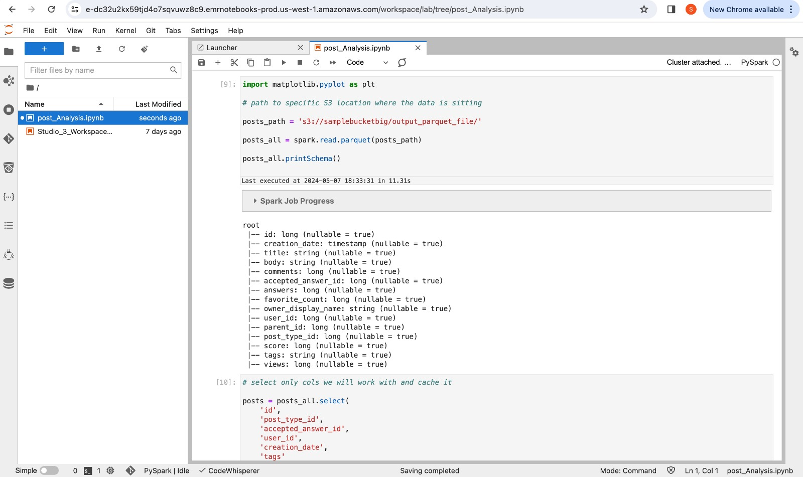
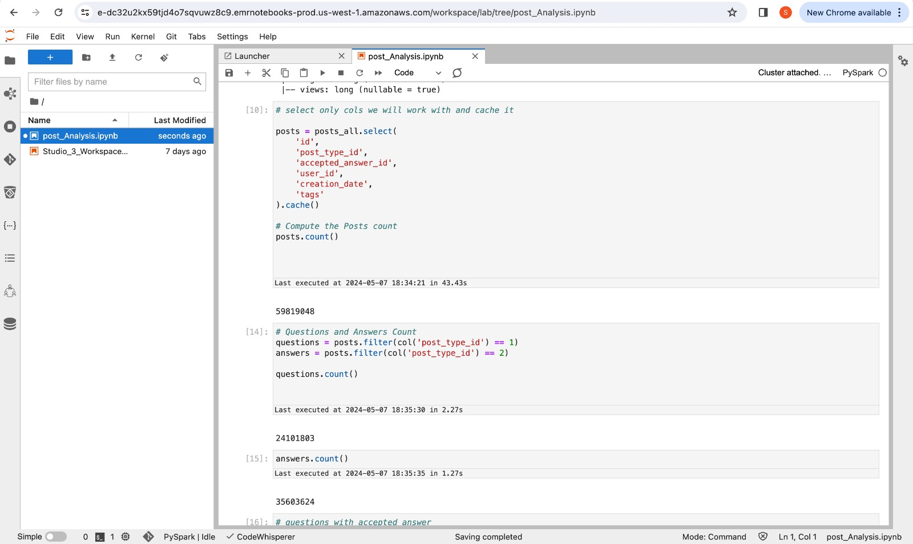
Data Analysis
Analysis on the type of posts on the Stackoverflow dataset

Slide 23
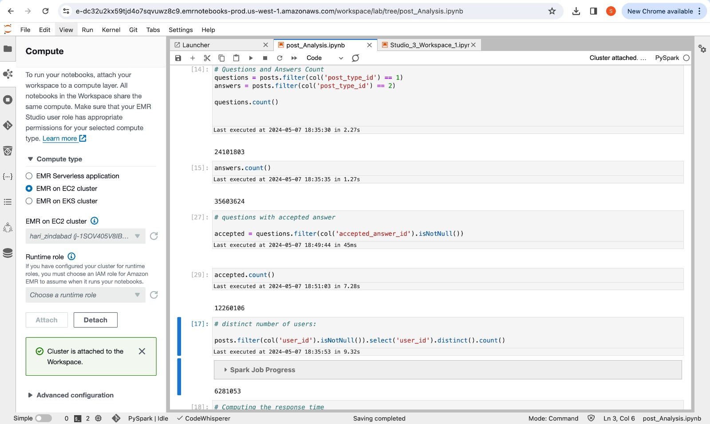
Data Analysis

Slide 24
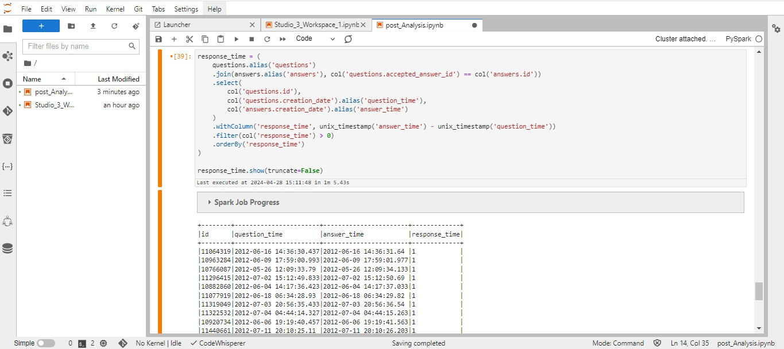
Computing response time
Difference of the question posting time and the accepted answer date time.

Slide 25
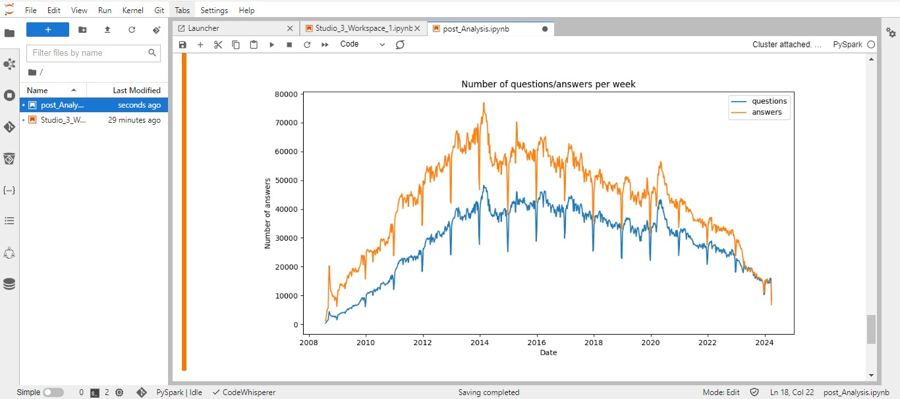
Number of Questions/Answers evolve over time: Below graph shows the trend of questions and answers over the period(2008 – 2022)

Slide 26
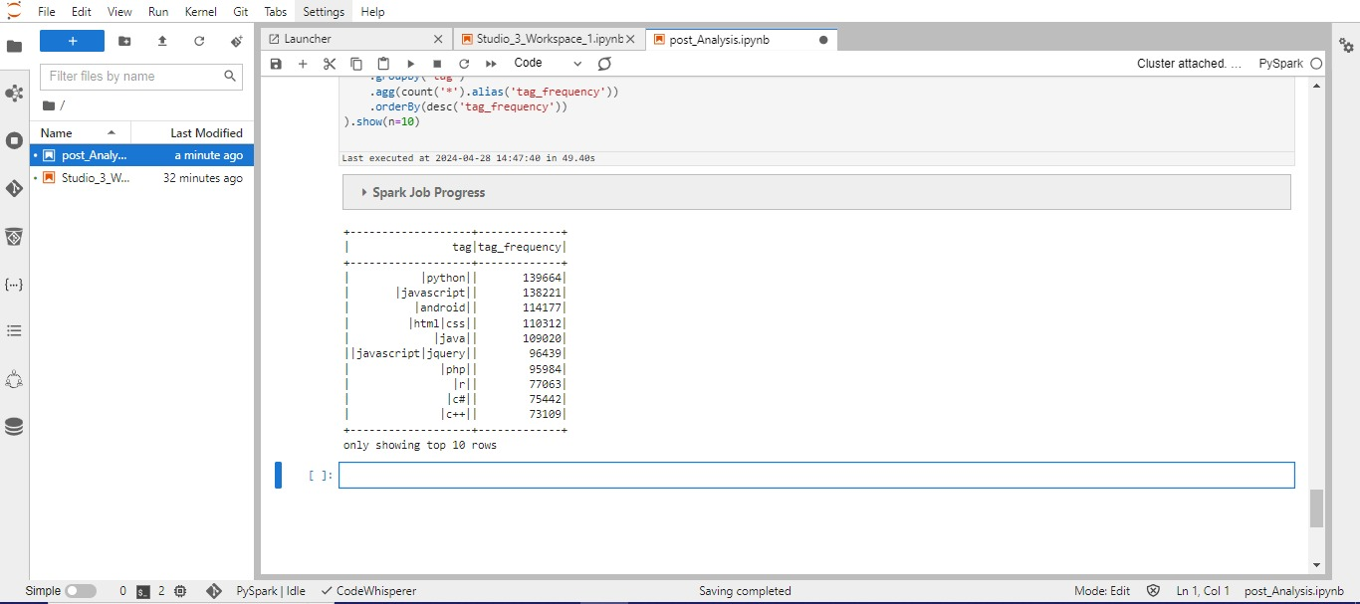
Count of number of tags: It has around 61662 tags from which below are the top 10 rows

Slide 27
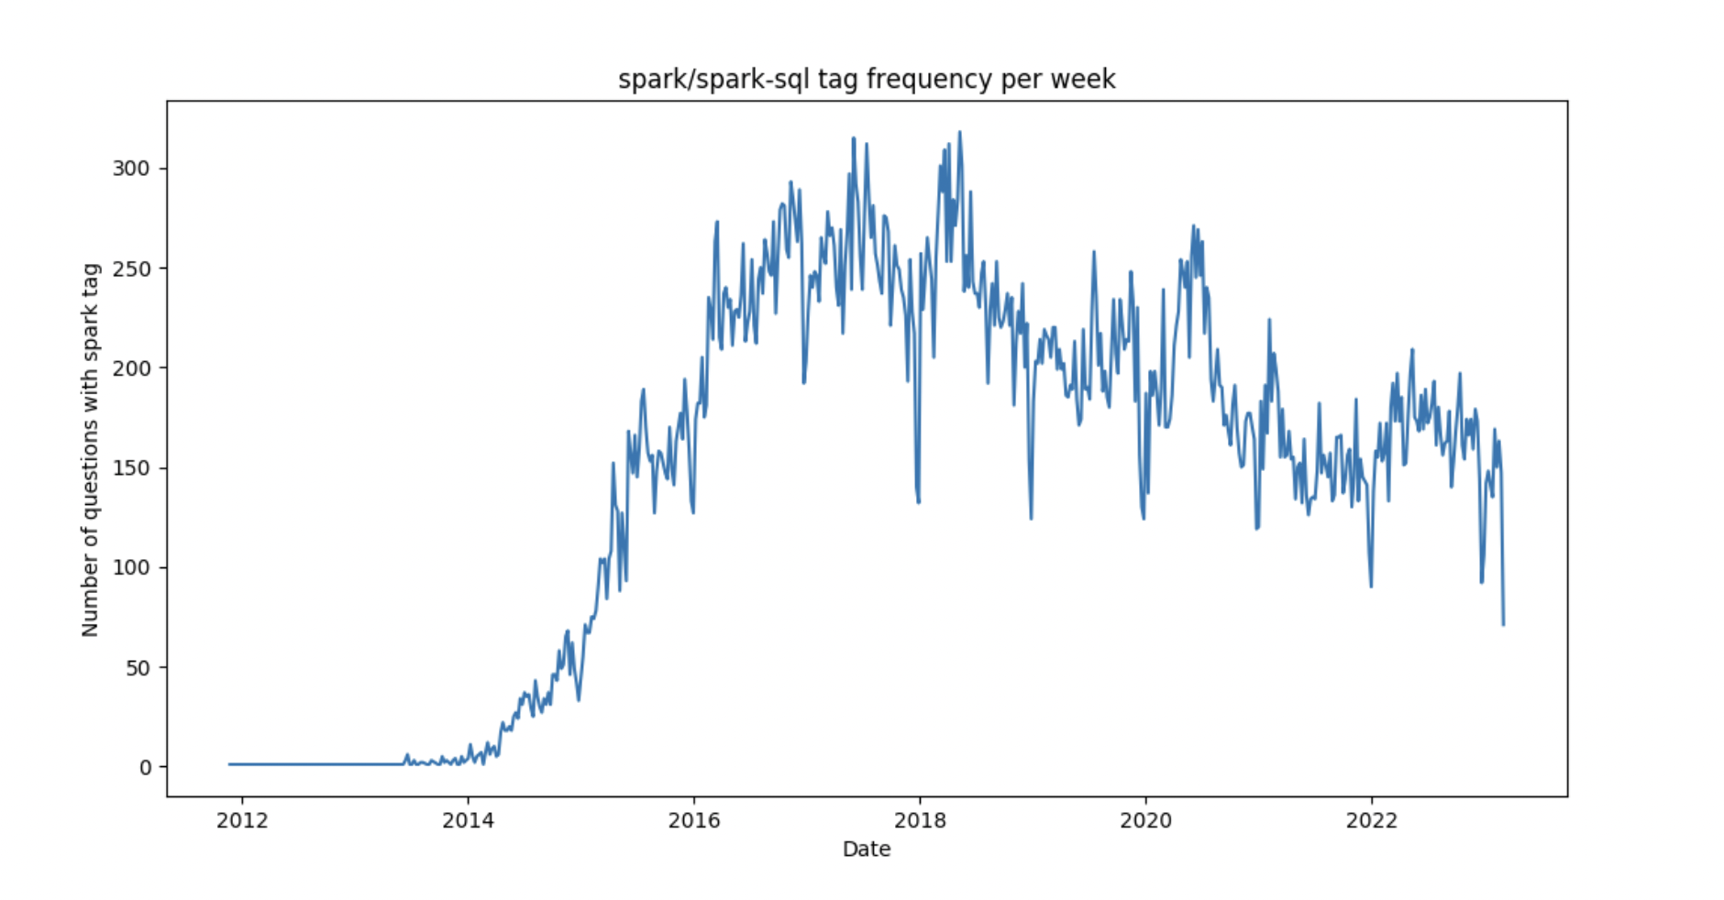
Popularity of spark/spark-sql tag over the period (2012-2022)

Slide 28
Conclusion
In this project, we are going to implement a holistic approach using a number of AWS services and tools such as EC2, S3, EMR, Glue, Redshift, PySpark, and data analysis for visualization while analyzing Stack Overflow data.
It has all these technologies incorporated in it, enabling this project to effectively process, convert, and visualize Stack Overflow archive data.
Hence it provides an easy way for users to have access to intuitive insights, hence data security based on user authentication.
In general, that is a realization of how modern techniques of processing and visualizing data become powerful when dealing with huge datasets.

Slide 29
Future Work
Stack Overflow Analysis project uses the most progressive and up-to-date technical solutions that work on a publisher-sub-subscriber model and data analysis for the operations in data processing and visualization.
For example, with the publisher-subscriber model, data from Stack Overflow can be efficiently streamed onto an S3 bucket from where the same can be centrally stored for scalability and dependability.
Using Stack Analysis’s powerful visualization capabilities, dynamic dashboards are generated to reveal insights from Stack Overflow data and, therefore, allow users to find trends and patterns.
These new features further reveal how Stack Overflow is making a serious advancement in data-driven insights that benefit the analysts, developers, and companies using their platform for collaboration and knowledge exchange.

Slide 30
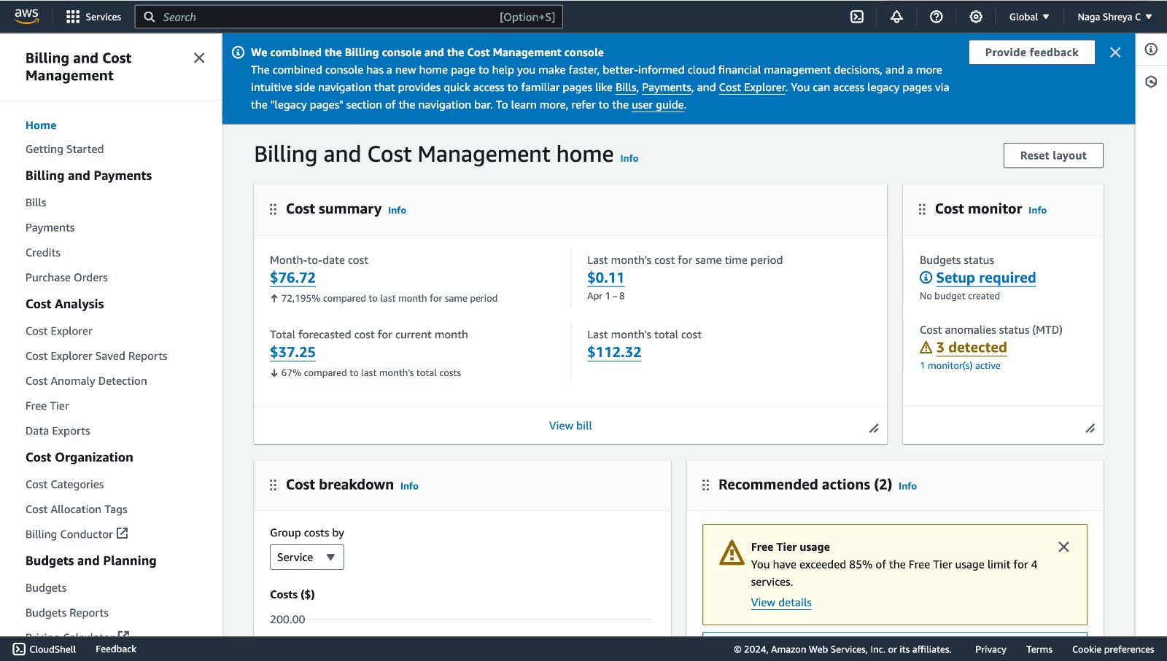
Billing of Project

Slide 31
Thank You

